Slide 1
BUBT BAPS Programming Camp 2025
Intermediate Graph
RakibJoy

Slide 2
DSU
What DSU basically does? What basic problem it solves?
Is it useful for only finding the same component related problem?
We going to figure it out.

Slide 4
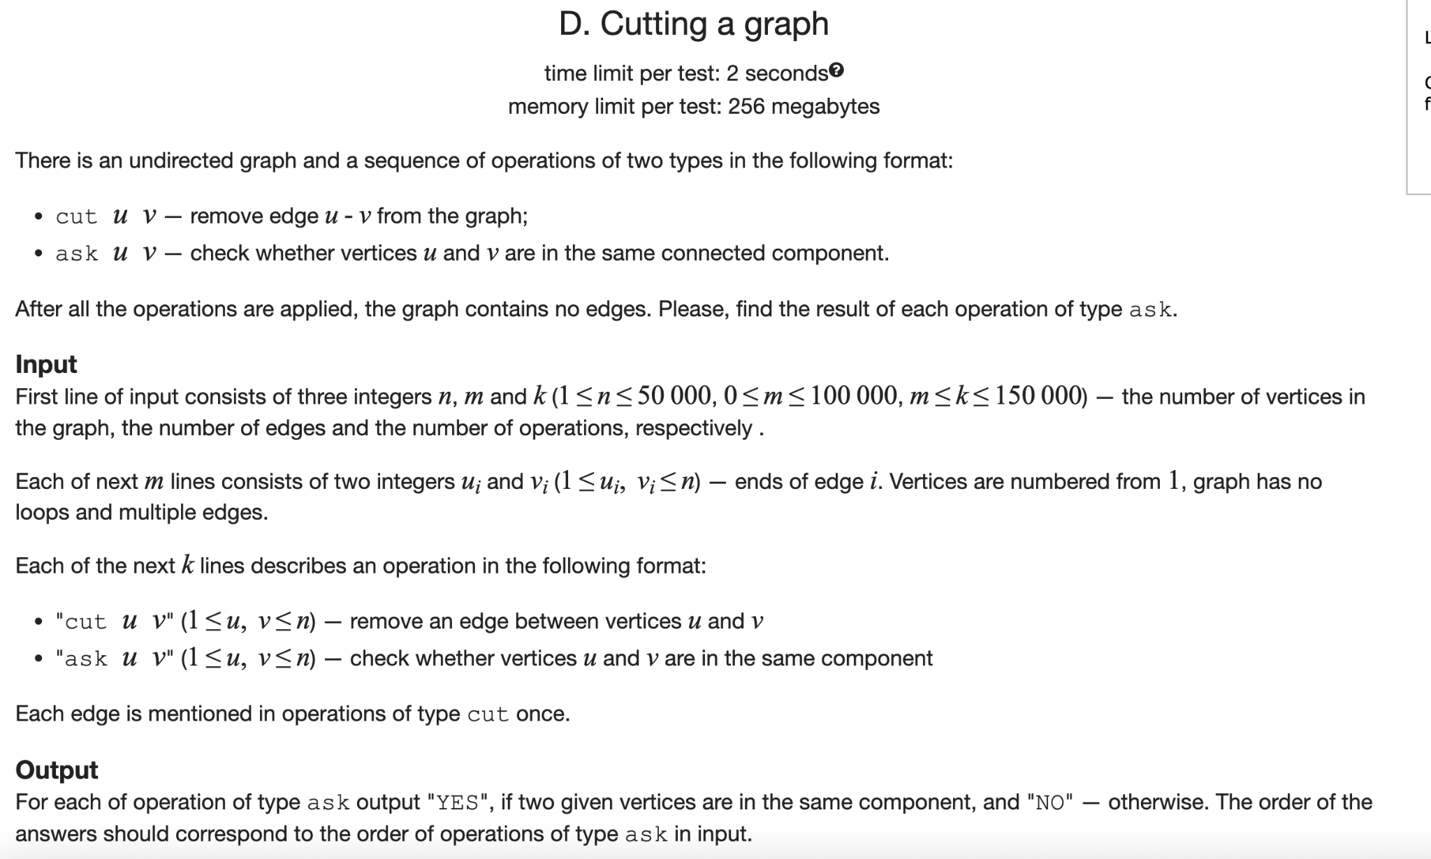

Slide 5
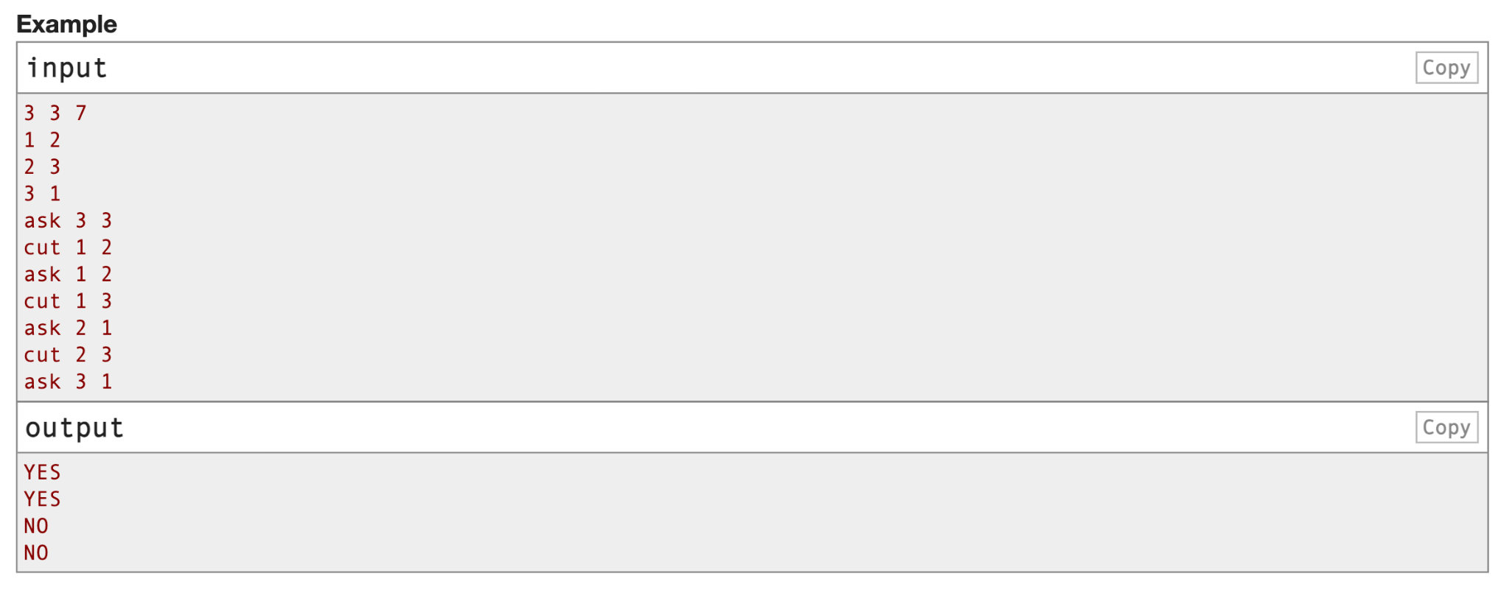

Slide 7
Useful thing from DSU
Merging N items in NlogN complexity

Slide 8
DSU on Tree
How that NlogN idea helps us to apply DSU on Tree? It is also called small to large merging.

Slide 9
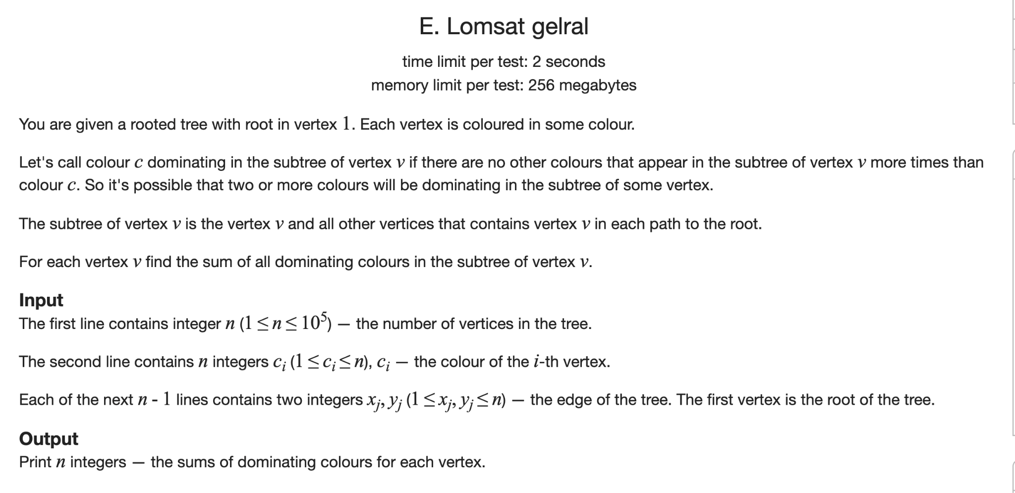

Slide 10
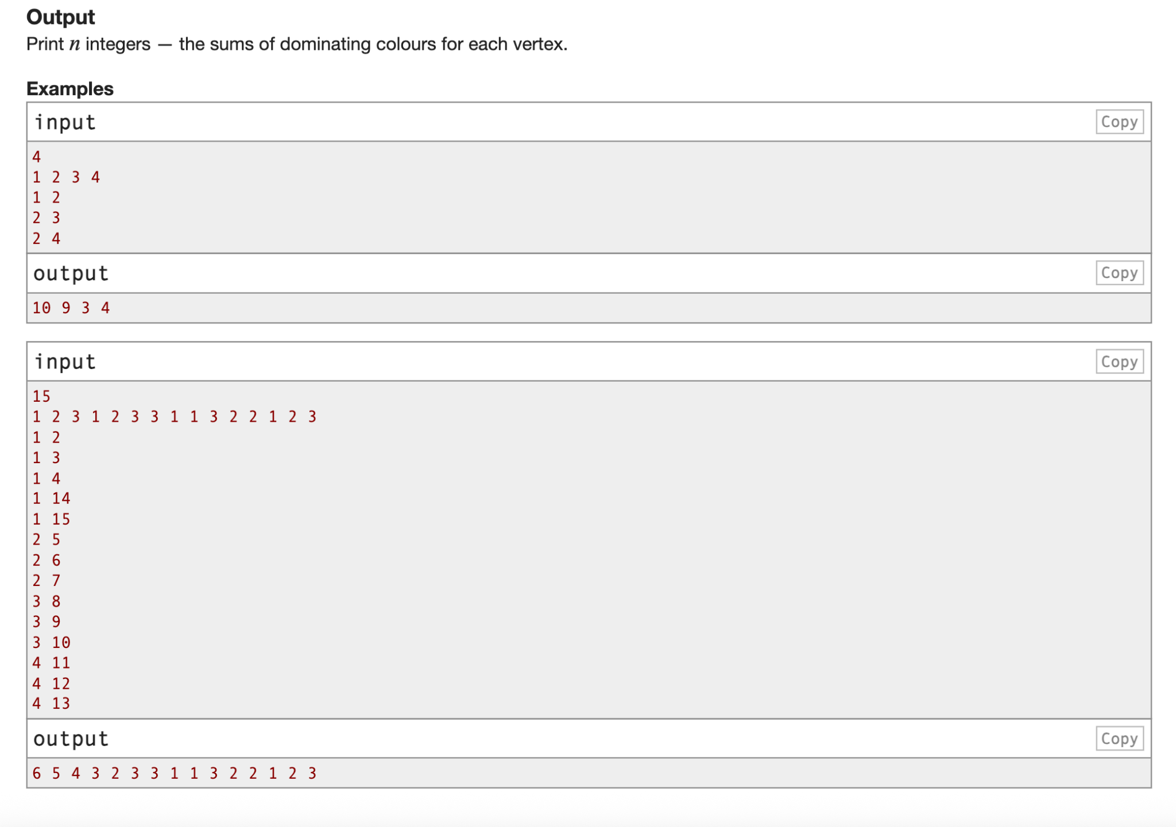

Slide 11
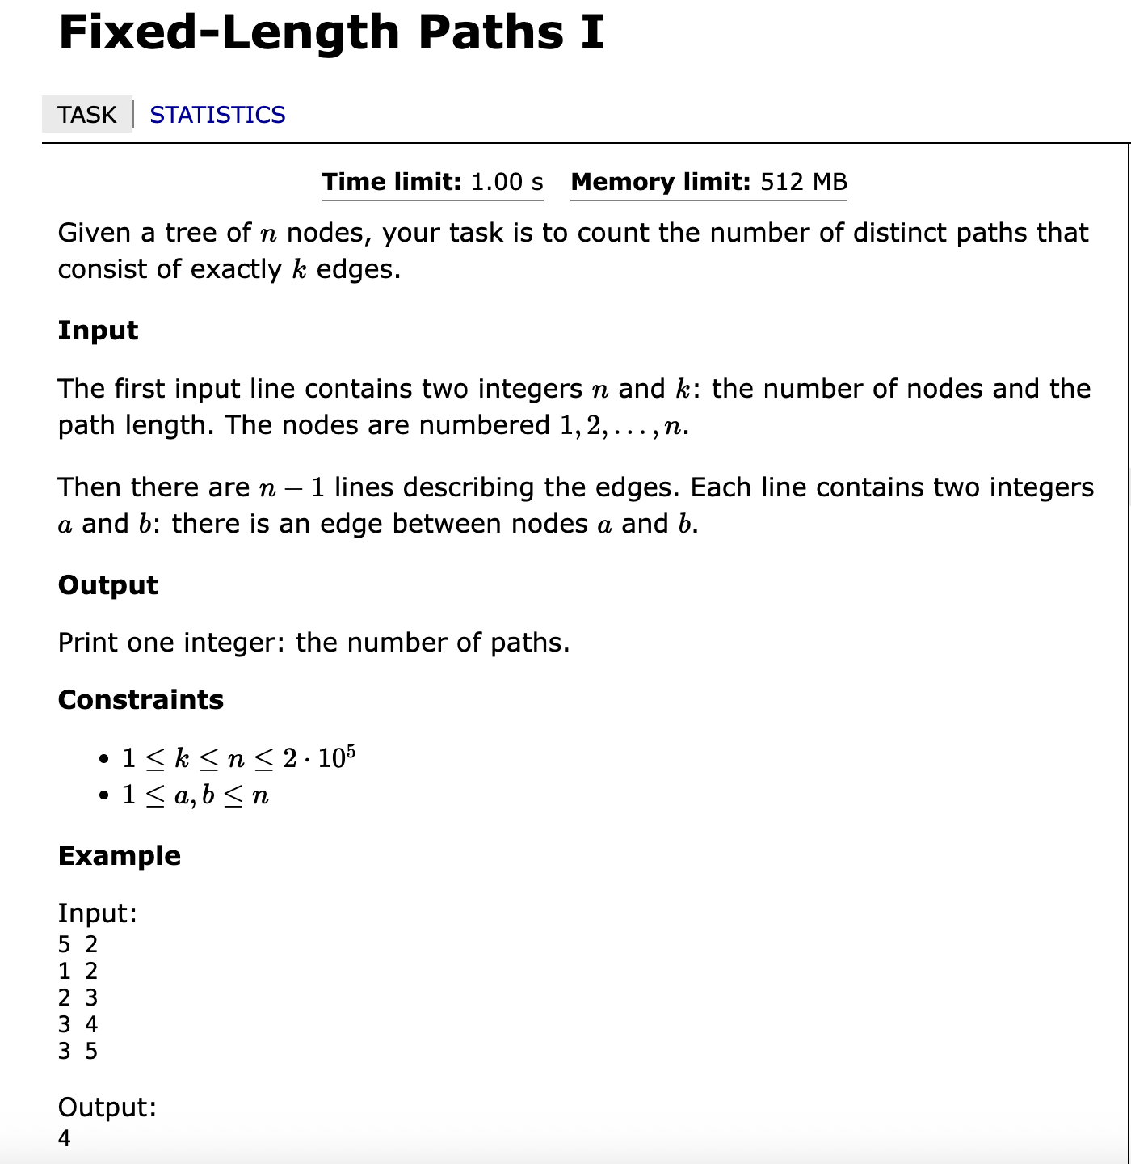

Slide 13
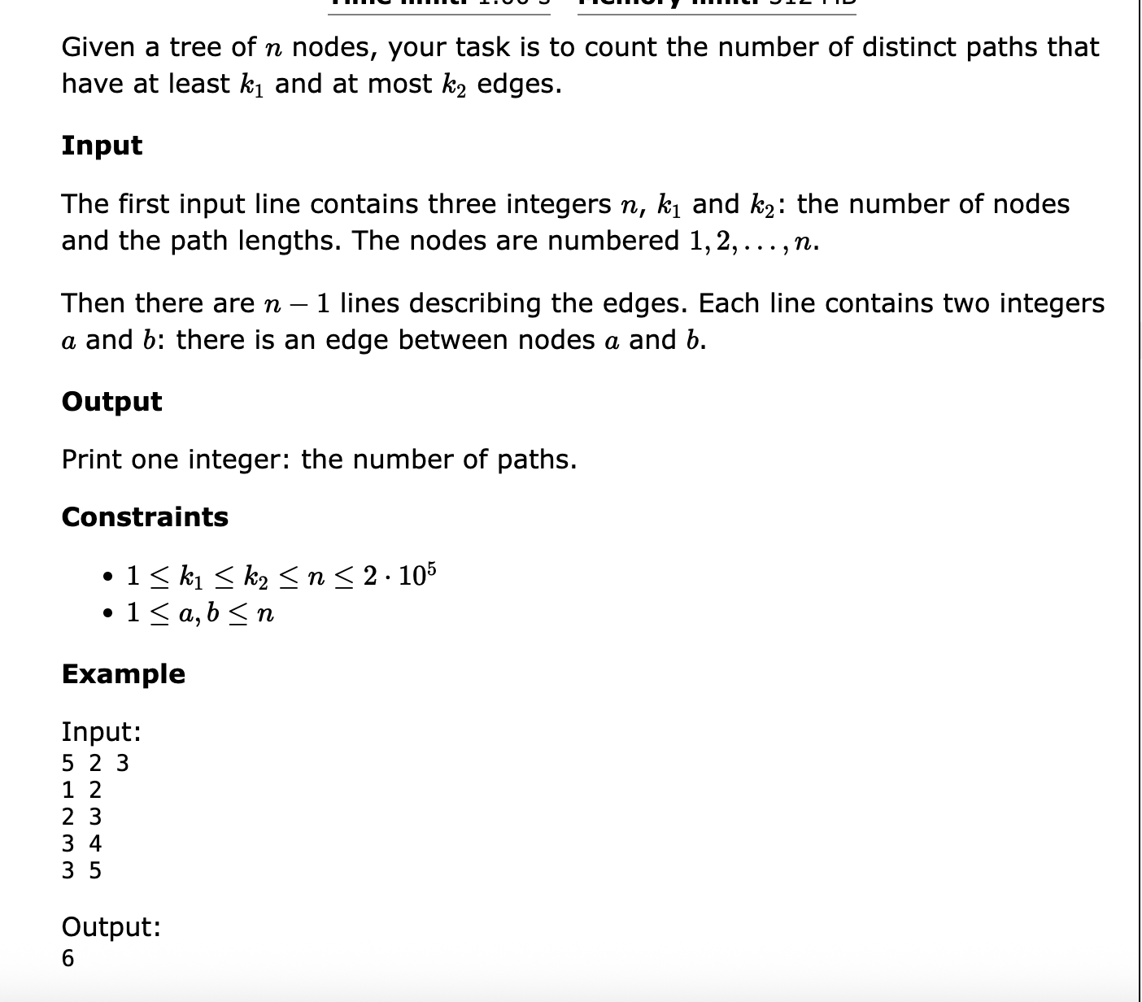

Slide 14
Kruskal Reconstruction Tree
Also called Reachability Tree.
How does it work?

Slide 15
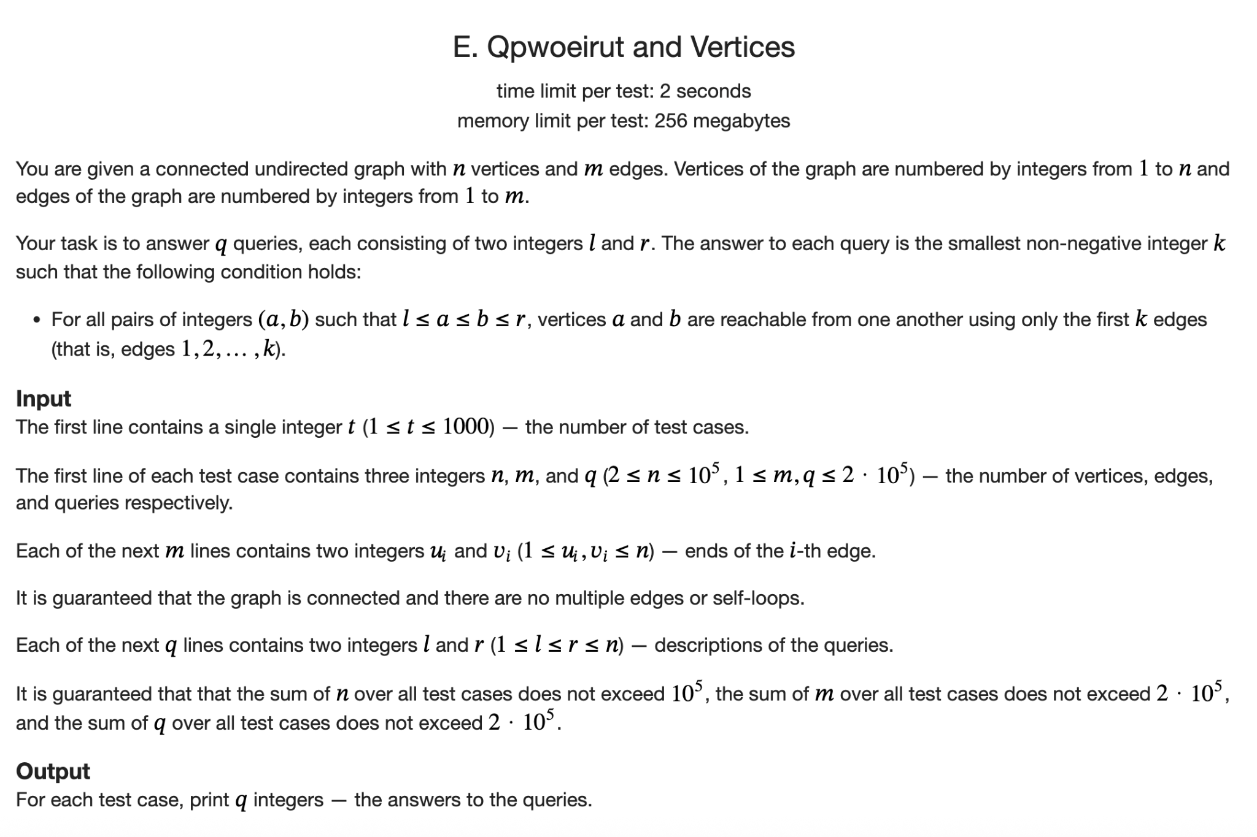

Slide 16
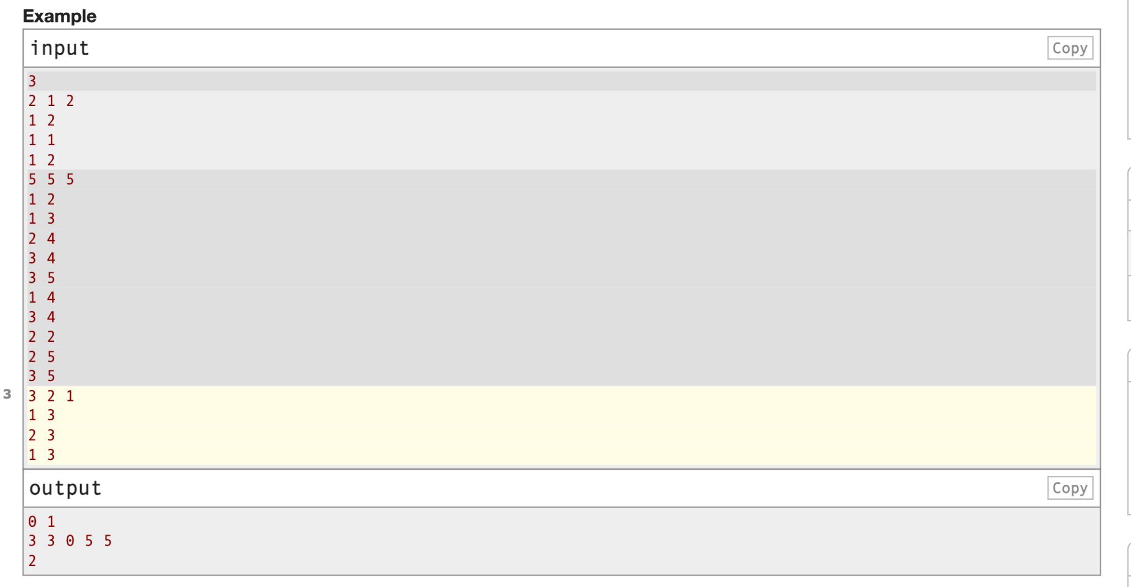

Slide 17
Can we use this trick if we need to determine the maximum edge between two nodes of a tree?

Slide 18
More DSU - If you are interested
https://codeforces.com/problemset/problem/2021/E2
Weighted DSU - https://atcoder.jp/contests/abc328/tasks/abc328_f

Slide 19
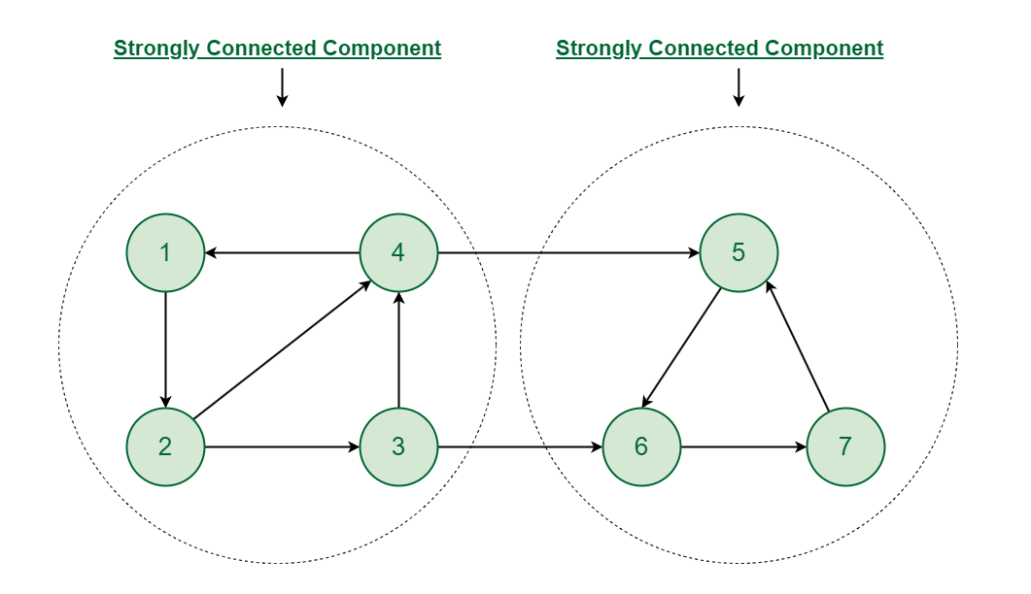
Strongly connected component

Slide 20
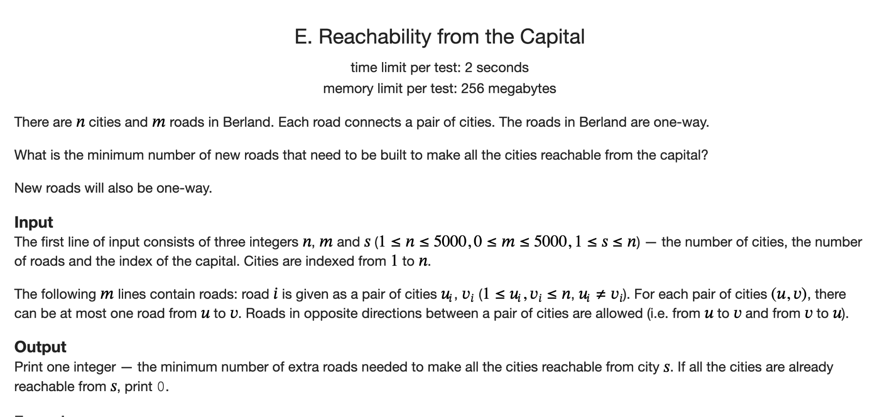

Slide 21
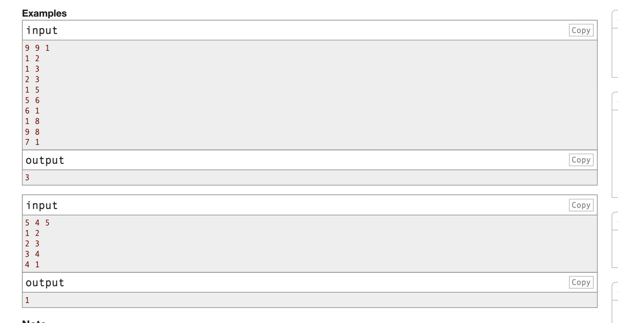

Slide 22
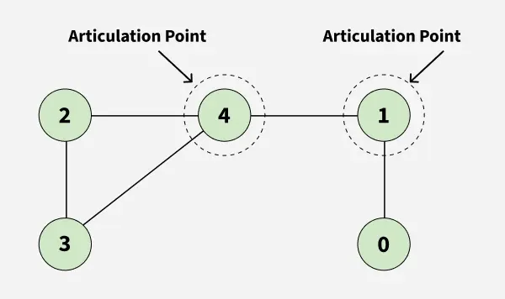
Articulation Point

Slide 23
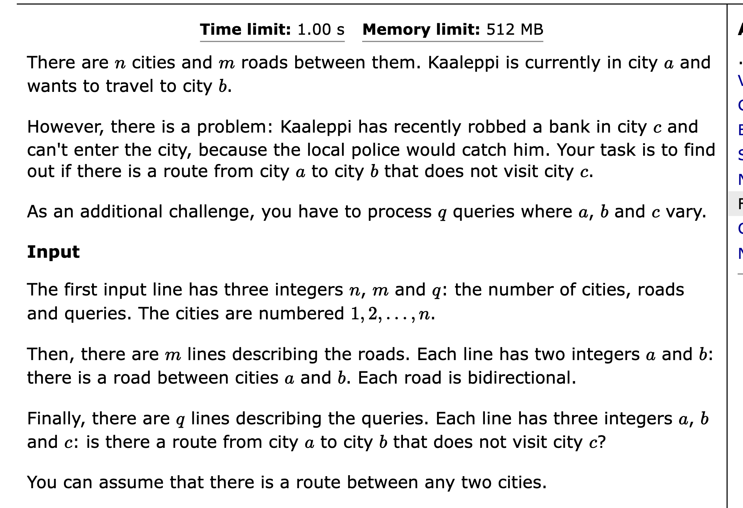

Slide 24
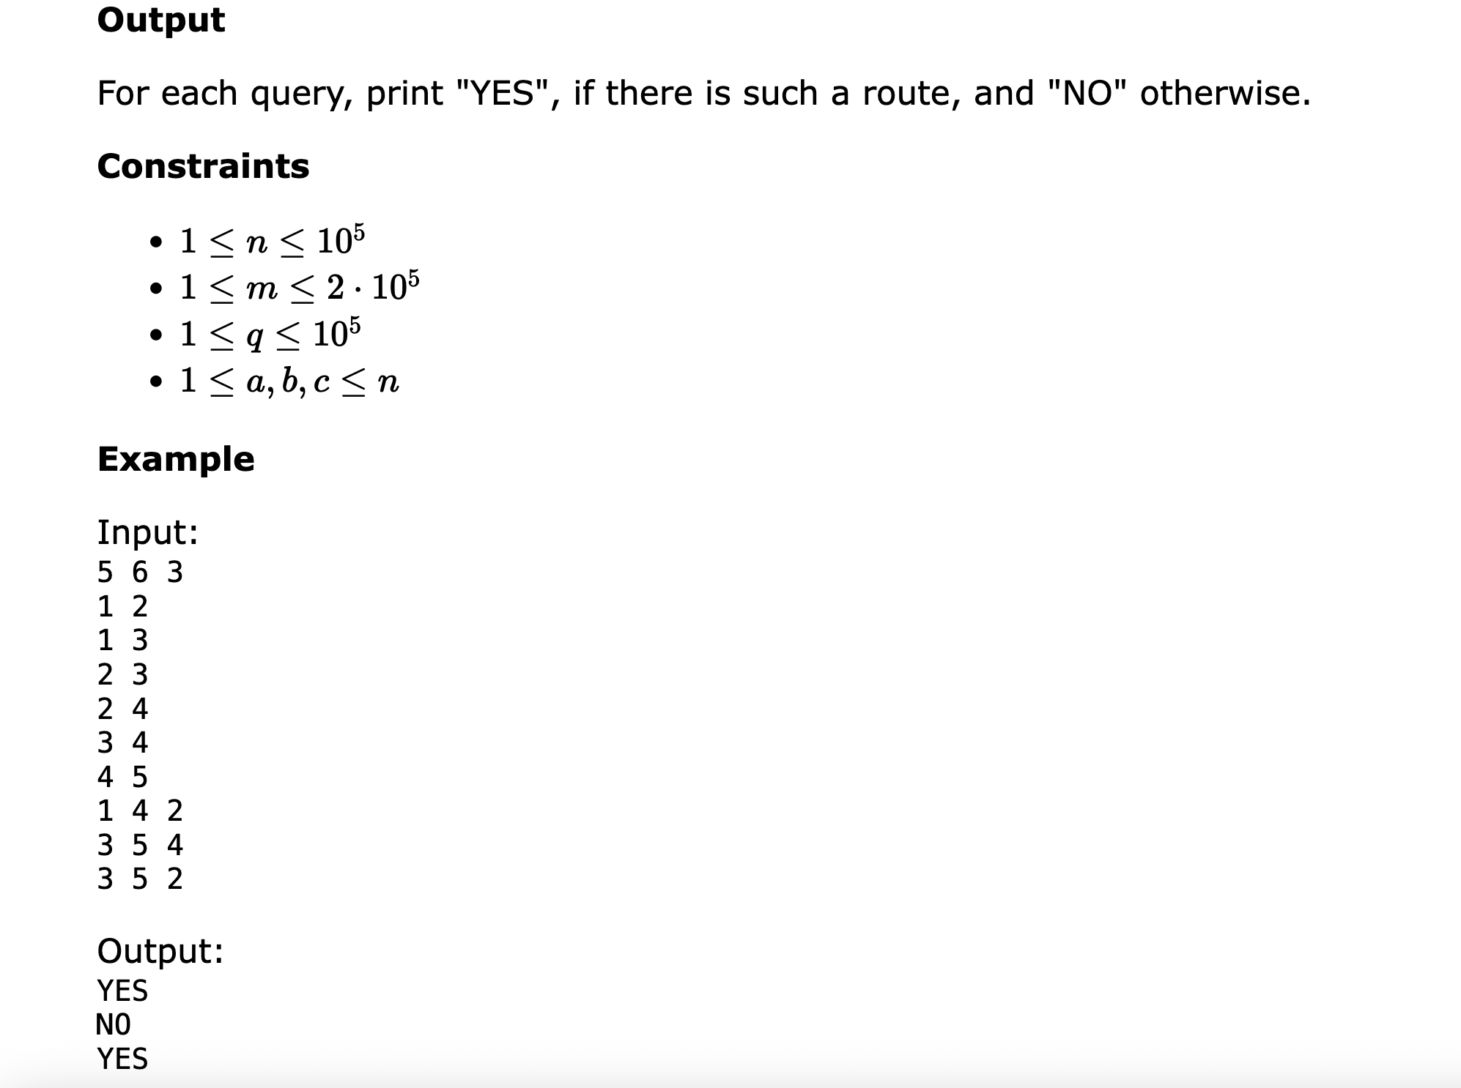

Slide 25
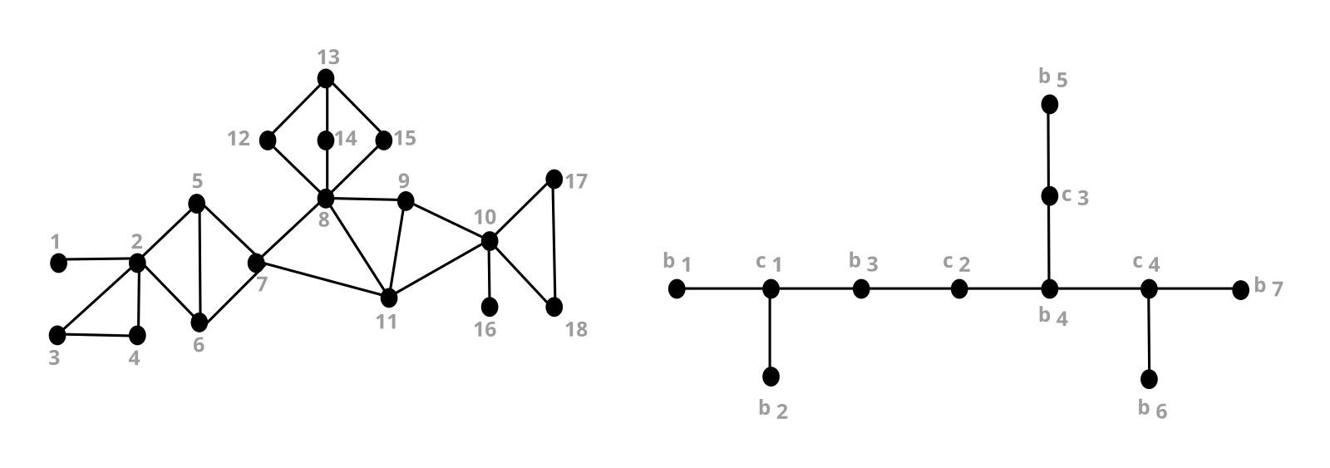

Slide 26
A graph, and its block-cut tree.
Blocks:
b₁ = [1,2]
b₂ = [2,3,4]
b₃ = [2,5,6,7]
b₄ = [7,8,9,10,11]
b₅ = [8,12,13,14,15]
b₆ = [10,16]
b₇ = [10,17,18]
Cutpoints:
c₁ = 2
c₂ = 7
c₃ = 8
c₄ = 10

Slide 28
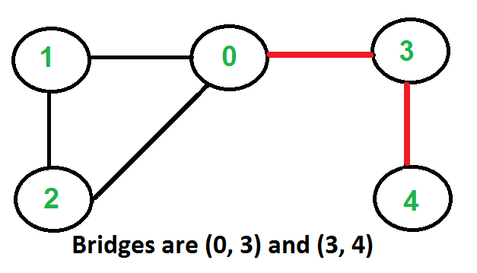
Articulation Bridge

Slide 29
Problem
You are given a tree. You have to add minimum number of edges such that there will be no articulation points and bridges there.

Slide 30
The answer is always (number of leaves +1)/2

Slide 31
What if the tree is a normal graph?

Slide 32
Bi Connected Component
There will be no articulation point.
If we delete any node, the rest of the nodes will be still connected.

